Slide 1
Decision trees
A decision tree is a supervised learning algorithm used for both classification and regression tasks.
It has a hierarchical tree structure which consists of a root node, branches, internal nodes and leaf nodes.
It works like a flowchart help to make decisions step by step where:
Internal nodes represent attribute tests
Branches represent attribute values
Leaf nodes represent final decisions or predictions.
Decision trees are widely used due to their interpretability, flexibility and low preprocessing needs.

Slide 2
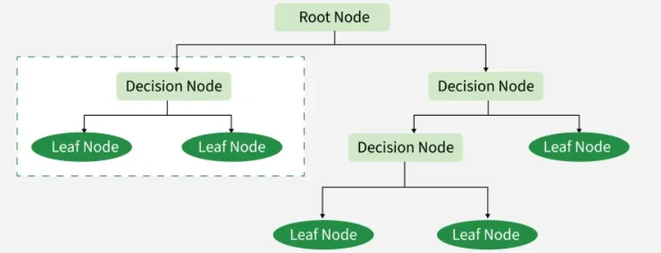
Decision trees

Slide 3
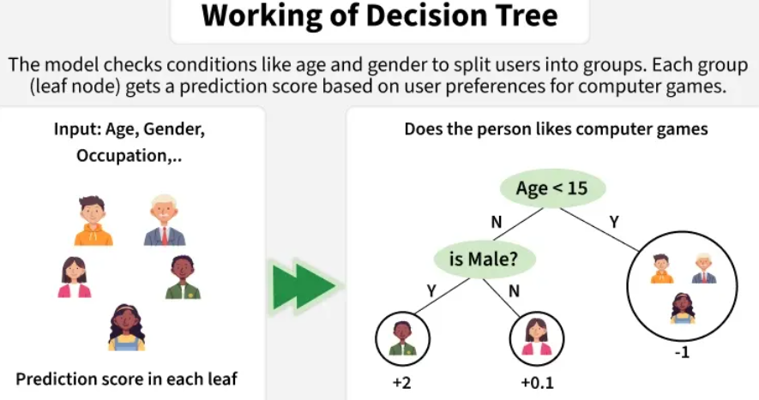

Slide 4
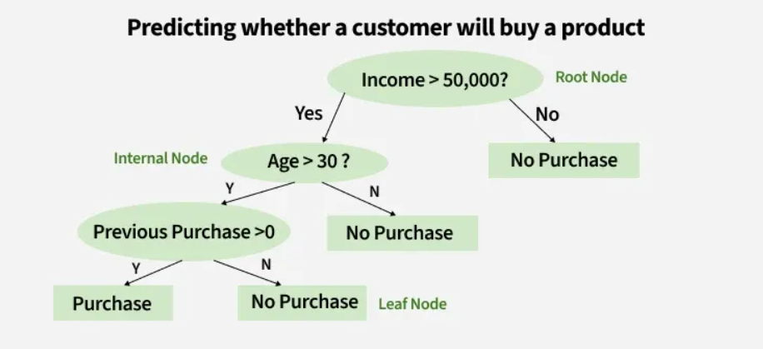
How Does a Decision Tree Work
A decision tree splits the dataset based on feature values to create pure subsets ideally all items in a group belong to the same class.
Each leaf node of the tree corresponds to a class label and the internal nodes are feature-based decision points. Let’s understand this with an example.

Slide 5
How Does a Decision Tree Work
Let’s consider a decision tree for predicting whether a customer will buy a product based on age, income and previous purchases: Here's how the decision tree works:
Root Node (Income)
First Question: "Is the person’s income greater than $50,000?"
If Yes, proceed to the next question.
If No, predict "No Purchase" (leaf node).
Internal Node (Age):
If the person’s income is greater than $50,000, ask: "Is the person’s age above 30?"
If Yes, proceed to the next question.
If No, predict "No Purchase" (leaf node).
Internal Node (Previous Purchases):
If the person is above 30 and has made previous purchases, predict "Purchase" (leaf node).
If the person is above 30 and has not made previous purchases, predict "No Purchase" (leaf node).

Slide 6
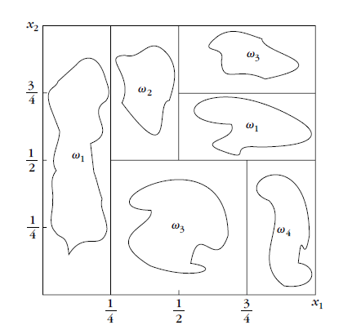
Decision Tree Example

Slide 7
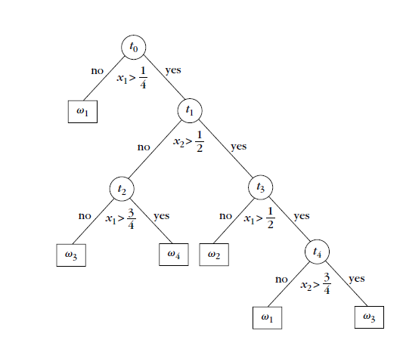
Decision Tree Example

Slide 8
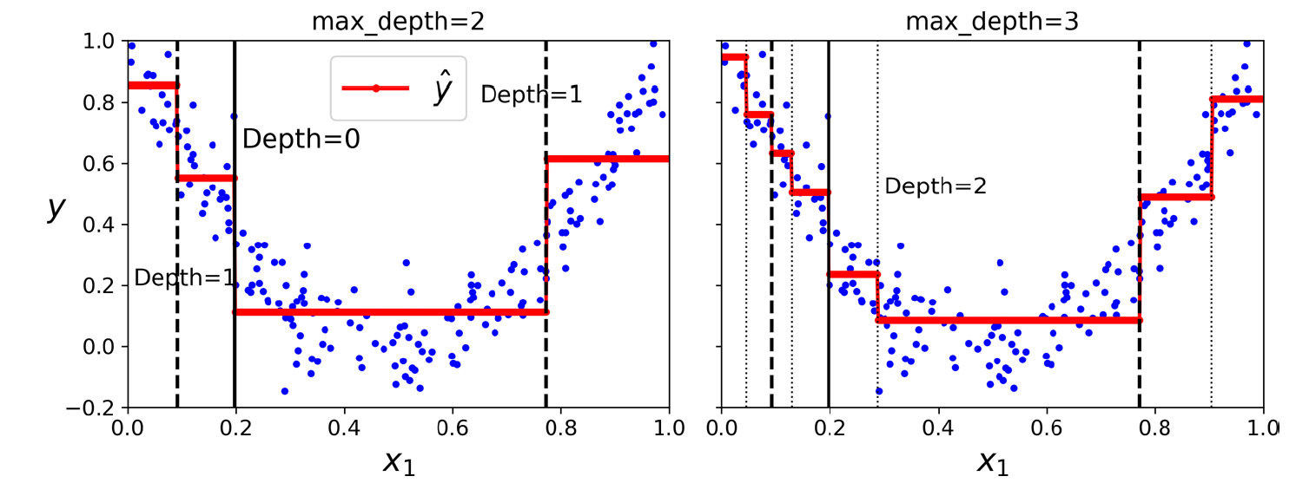
Predictions of two Decision Tree regression models

Slide 9
Decision Tree Training Measures and Splitting Criteria
Decision tree training involves selecting the best attribute at each node to split the dataset such that the resulting subsets are as pure as possible. This is achieved using different impurity and optimization measures.
Entropy of Dataset
Information Gain (IG)
Gini Index
Gain Ratio

Slide 10

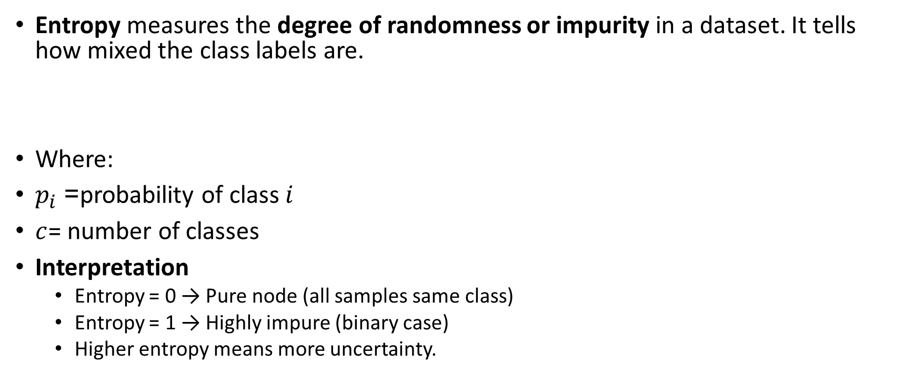
1. Entropy of Dataset
Entropy measures the degree of randomness or impurity in a dataset. It tells how mixed the class labels are.
Where:
$p_{i}$= probability of class $i$
$c$= number of classes
Interpretation
Entropy = 0 → Pure node (all samples same class)
Entropy = 1 → Highly impure (binary case)
Higher entropy means more uncertainty.

Slide 11

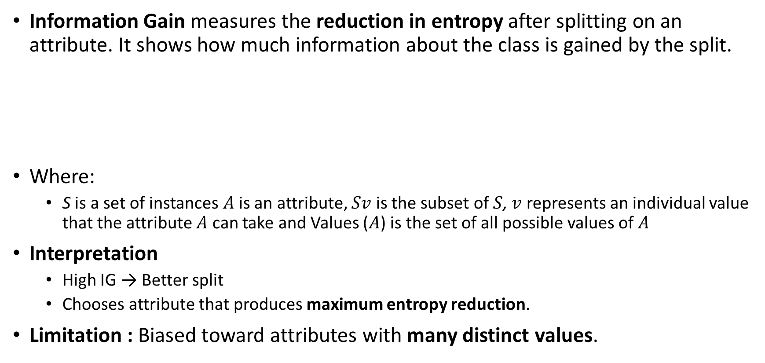
2. Information Gain (IG)
Information Gain measures the reduction in entropy after splitting on an attribute. It shows how much information about the class is gained by the split.
Where:
S is a set of instances $A$ is an attribute, $Sv$ is the subset of $S$, $v$ represents an individual value that the attribute $A$ can take and Values ($A$) is the set of all possible values of $A$
Interpretation
High IG → Better split
Chooses attribute that produces maximum entropy reduction.
Limitation : Biased toward attributes with many distinct values.

Slide 12
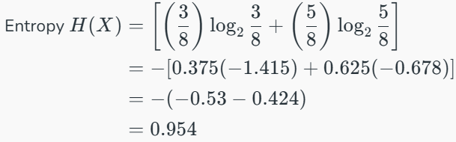
2. Information Gain (IG)
For example, if we split a dataset of people into "Young" and "Old" based on age and all young people bought the product while all old people did not, the Information Gain would be high because the split perfectly separates the two groups with no uncertainty left
Example: For the set X = {a,a,a,b,b,b,b,b}, Total instances: 8, Instances of b: 5, Instances of a: 3

Slide 13
Building Decision Tree using Information Gain the essentials
Start with all training instances associated with the root node
Use information gain to choose which attribute to label each node with
Recursively construct each subtree on the subset of training instances that would be classified down that path in the tree.
If all positive or all negative training instances remain, the label that node “yes" or “no" accordingly
If no attributes remain label with a majority vote of training instances left at that node
If no instances remain label with a majority vote of the parent's training instances.

Slide 14

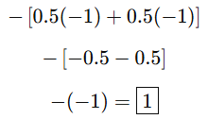
Example: Now let us draw a Decision Tree for the following data using Information gain. Training set: 3 features and 2 classes
E _{parent} = -[2/4log(2/4) + 2/4log(2/4)]
=
X | Y | Z | C
1 | 1 | 1 | I
1 | 1 | 0 | I
0 | 0 | 1 | II
1 | 0 | 0 | II
Here, we have 3 features and 2 output classes. To build a decision tree using Information gain. We will take each of the features and calculate the information for each feature.

Slide 15
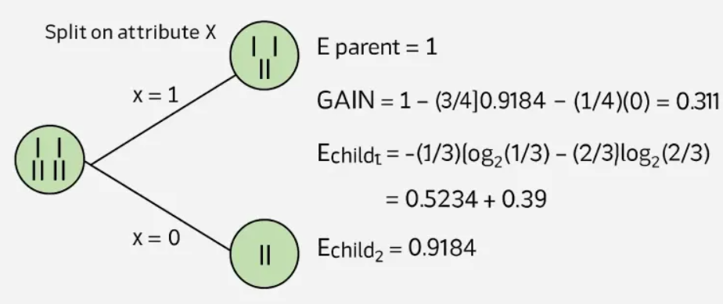

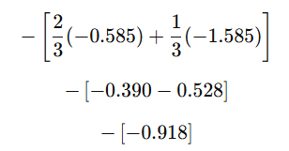

Example: Now let us draw a Decision Tree for the following data using Information gain. Training set: 3 features and 2 classes
GAIN = 1 – [(S_{child1}/S_{parent}) E(S_{child1}) +(S_{child2}/S_{parent}) E(S_{child2})]
E(S_{child1}) =
E(S_{child2}) = - 1/1 log(1/1) = 0

Slide 16
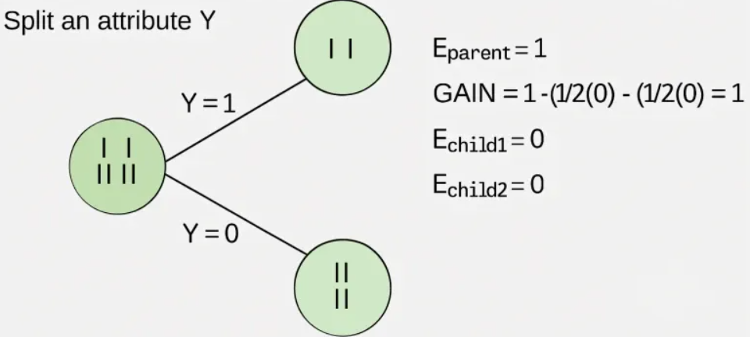
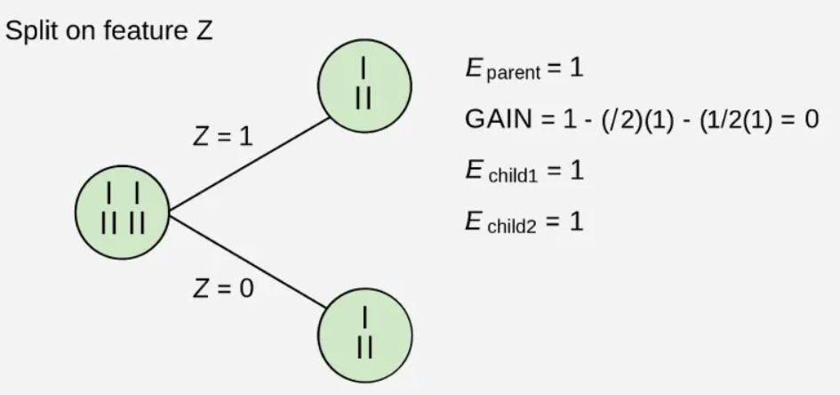
Example: Now let us draw a Decision Tree for the following data using Information gain. Training set: 3 features and 2 classes
From the above images we can see that the information gain is maximum when we make a split on feature Y. So, for the root node best-suited feature is feature Y. Now we can see that while splitting the dataset by feature Y, the child contains a pure subset of the target variable. So we don't need to further split the dataset. The final tree for the above dataset would look like this:

Slide 17

3. Gini Index
The Gini Index measures the probability of incorrect classification of a randomly chosen sample.
Interpretation: For example, if we have a group of people where all bought the product (100% "Yes") the Gini Index is 0 indicate perfect purity. But if the group has an equal mix of "Yes" and "No" the Gini Index would be 0.5 show high impurity or uncertainty.
Gini = 0 → Pure node, Lower Gini → Better split.
Usage
Used in CART (Classification and Regression Trees).
Advantage
Faster to compute than entropy.
Works well for large datasets.

Slide 18
Some additional features of the Gini Index are
It is calculated by summing the squared probabilities of each outcome in a distribution and subtracting the result from 1.
A lower Gini Index indicates a more homogeneous or pure distribution while a higher Gini Index indicates a more heterogeneous or impure distribution.
In decision trees the Gini Index is used to evaluate the quality of a split by measuring the difference between the impurity of the parent node and the weighted impurity of the child nodes.
Compared to other impurity measures like entropy, the Gini Index is faster to compute and more sensitive to changes in class probabilities.
One disadvantage of the Gini Index is that it tends to favour splits that create equally sized child nodes, even if they are not optimal for classification accuracy.
In practice the choice between using the Gini Index or other impurity measures depends on the specific problem and dataset and requires experimentation and tuning.

Slide 19


4. Gain Ratio
Gain Ratio improves Information Gain by removing its bias toward multi-valued attributes.
Where
Advantage: Avoids selecting attributes with many values.

